Slide 1
Contrast Media in Veterinary Radiology
Prof. Ibrahim Alrashid

Slide 2
A contrast medium is a substance that is administered to the patient that is either more radiopaque or more radiolucent than the surrounding tissue. This allows assessment of the position, size, shape and internal architecture of the organ that was not apparent on the original radiograph. :

Slide 3
Sequential films or the use of image-intensified fluoroscopy may also show the function of an organ, e.g., the rate of stomach emptying or the presence of peristalsis. Properties required in an ideal contrast medium include

Slide 4
Different absorptive power from tissue, thereby producing effective radiographic contrast;
1- No irritant or toxic side effects
2-accurate delineation of the organ
3-Persistence for sufficient time to take radiographs

Slide 5
TYPES OF CONTRAST MEDIA
1-Negative contrast studies will show the location, size and wall thickness of the organ and will show marked wall thickening and large luminal filling defects such as masses or foreign bodies.
2-Positive contrast studies give little more information than negative contrast studies but are the best way of detecting a small defect in the wall of the organ, as minor contrast leakage is easily seen.

Slide 6
POSITIVE CONTRAST MEDIA
1.Barium sulphate preparations
2.Iodine preparations
a) Ionic, water-soluble iodine contrast media
b) Non-ionic, water-soluble iodine contrast media

Slide 7
Radiation safety
Radiation safety principles aim to limit exposure to ionising radiation for radiation therapy personnel, people affected by cancer and the general public. Wherever there is known risk of exposure to ionising radiation, health professionals must be guided by the ALARA (as low as reasonably achievable) principles of radiation safety for time, distance and shielding.

Slide 8
Time
The less time spent near a radiation source, the less radiation absorbed. This is especially important for personnel such as radiation therapists
Distance
The inverse-square law states that radiation exposure and distance are
inversely related.

Slide 9
Shielding
The type of shielding device used depends on the range of emission of the radioactive source. Standard shielding devices include lead aprons,
thyroid shields, and eye shields

Slide 10
Spill management
In the event of a radiation incident, such as the loss of a source or a spill, appropriate procedures and notifications must be followed. These should be clearly outlined in the clinical environment as part of radiation safety and hospital policy.

Slide 11
Modern Diagnosis
CT (Computed Tomography) Scan
A computerized tomography scan (CT or CAT scan) uses computers and rotating X-ray machines to create cross-sectional images of the body. These images provide more detailed information than normal X-ray images. They can show the soft tissues, blood vessels, and bones in various parts of the body. A CT scan may be used to visualize the:
head
shoulders
spine
heart
abdomen
knee
chest

Slide 12
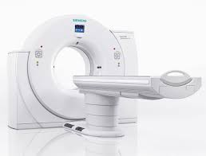
CT (Computed Tomography) Scan

Slide 13
Magnetic Resonance Imaging (MRI) scan
MRI uses a strong magnetic field and radio waves to create detailed images of the organs and tissues within the body. Since its invention, doctors and researchers continue to refine MRI techniques to assist in medical procedures and research. The development of MRI revolutionized medicine.

Slide 14
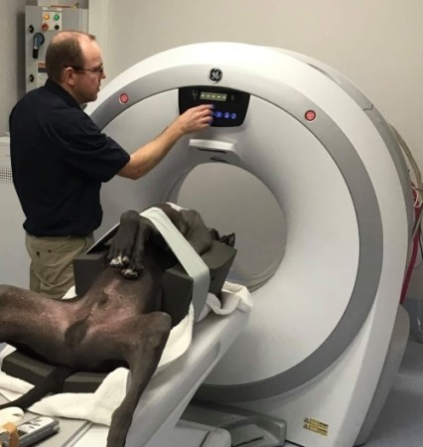
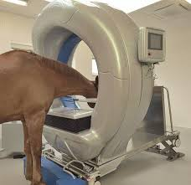
(MRI) scan

Slide 15
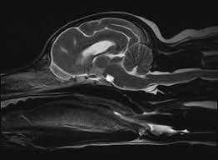

Slide 16
Functional magnetic resonance imaging (fMRI)
Functional magnetic resonance imaging or functional MRI (fMRI) uses MRI technology to measure cognitive activity by monitoring blood flow to certain areas of the brain.
The blood flow increases in areas where neurons are active. This gives an insight into the activity of neurons in the brain.
This technique has revolutionized brain mapping, by allowing researchers to assess the brain and spinal cord without the need for invasive procedures or drug injections.

Slide 17
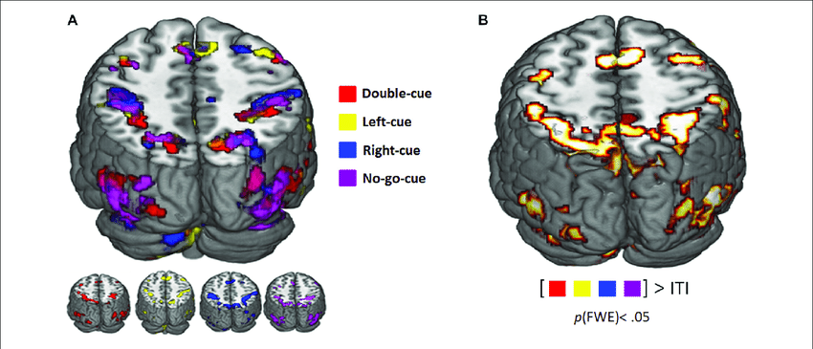
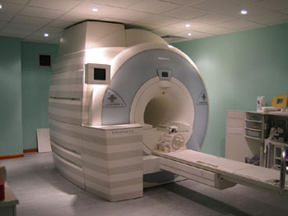
Functional magnetic resonance imaging (fMRI)

Slide 18
Ultrasound
 Ultrasound is a type of imaging. It uses high-frequency
sound waves to look at organs and structures inside
the body.
 Health care professionals use it to view the heart,
blood vessels, kidneys, liver, and other organs.
 During pregnancy, doctors use ultrasound to view the
fetus. Unlike x-rays, ultrasound does not expose you to radiation.

Slide 19
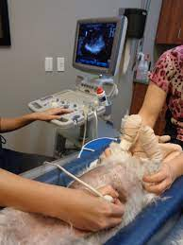

Slide 20
Digital Radiography (DR)
Digital X-ray replaces the use of film or computed radiography (CR) plates with a direct digital transfer of X-ray images into the PACS. Digital radiography (DR) is the direct conversion of transmitted X-ray photons into a digital image using an array of solid-state detectors such as amorphous selenium or silicon, with computer processing and display of the image

Slide 21
GAMMA CAMERA
An electronic device that detects gamma rays emitted by radio pharmaceautical (e.g technetium 99m (Tc-99m) that have been introduced into the body as tracers. The position of the source of the
radioactivity can be plotted and displayed on a TV monitor or photographic film.

Slide 22
